Slide 1
A story by: Iceland,Spain and Poland

Slide 2
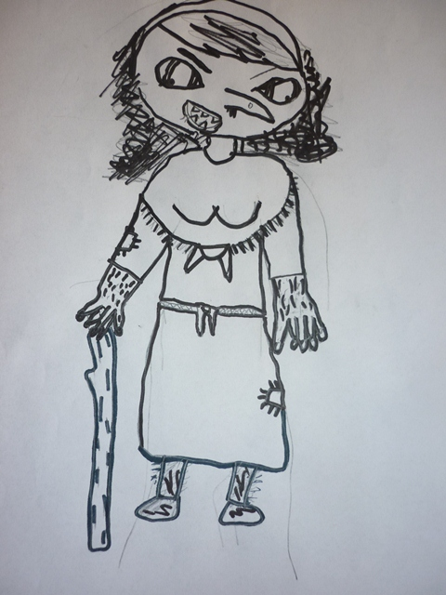
1 Chapter – iceland Grýla goes on a holiday
Christmas had passed and Grýla, santa clauses mom was standing inside her cave. She was ironing all the thirteen Santa costumes because they were all back from visiting all the good children in Iceland. It was so much noice in the cave and Grýla was very tired. She looked at the newspaper and decided to go somewhere where she could relax.

Slide 3
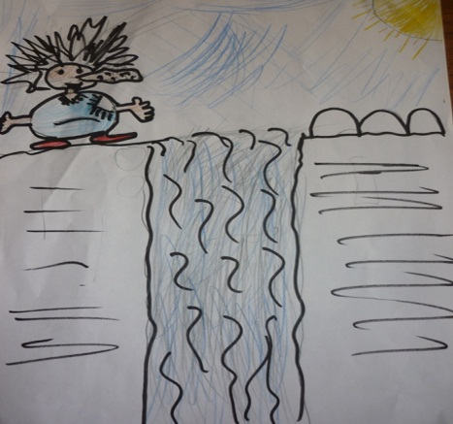
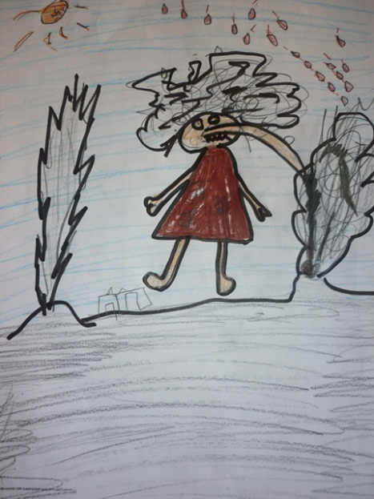
1 Chapter – iceland Grýla goes on a holiday
. She decided to go to Reykjavik capital of Iceland. On the way there she passed Gullfoss and she wanted to take a bath before she left. She jumped in to the waterfall. After a while she heard a lot of noice and looked up and saw many turist screaming: Get out of the waterfall we don´t want to have you in our pictures. Grýla was so scair that she ran all the way to Reykjavík.

Slide 4
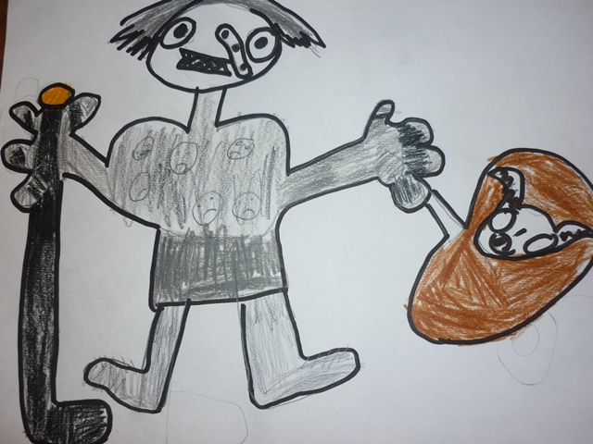
1 Chapter – iceland Grýla goes on a holiday
Ther she went into the travel agency and wanted to get a ticket to Canary Island. But she didn´t have any money so she decided to go to the airport to see if she could sneak into some jet there. She was very hungry and she went to the Farm animal zoo in Reykjavík and took a sheep and eat it.

Slide 5
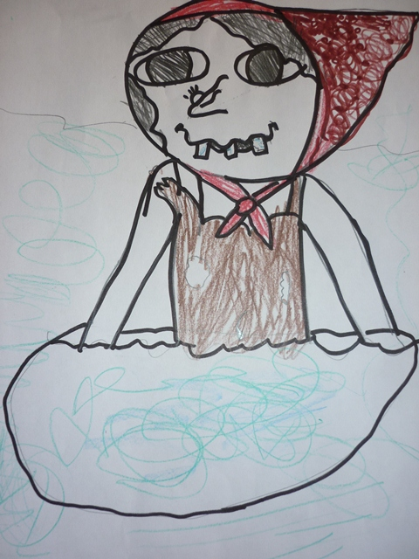
1 Chapter – iceland Grýla goes on a holiday
Now she was ready to go to the airport. On her way she passed the Blue lagoon. Oh said Grýla it would be wonderfull to take a bath in the hot springs here and so she did. She spent a little time there and then she kept going to the airport. When she came there she saw a big jet and the door was open. She looked around and saw noone then she sneked into the jet and sat down. She was very tired and fell a sleep When she woke up the jet had landed in Canary Island….

